Slide 1
Advanced Computational Methods in Geotechnical Engineering
Lecture
March 19, 2009

Slide 2
References:
Bathe, K.J., Finite Element Procedures (Available in pdf format).
Rao, S.S., The Finite Element Method in Engineering (Available in pdf format).
Zenkiewicz O.C. & Taylor, R.L. (2000), The Finite Element Method, Vol. I & II (Available in pdf format).
Budhu, M. (2007): Soil Mechanics and Foundations, Wiley & Sons (a CD-ROM available).
Wood, D. M. (1990): Soil behavior & CSSM, Cambridge (available in pdf format).
Any other FDM or FEM reference (Internet, etc…)

Slide 3
General Introduction
Many problems in engineering are governed by differential or integral equations.
The solutions to these equations would provide an exact, closed-form solution to the particular problem being studied.

Slide 4
However, complexities in the geometry, loadings, properties and boundary conditions that are seen in most real-world problems usually mean that an exact solution cannot be obtained or obtained in a reasonable amount of time.
Therefore, it is necessary to seek and rely on a computational solution.

Slide 5
This fundamental necessity and the steadfast improvement in the speed and memory size of computers since the 1950s have led to the emergence of computational Mechanics.
Consequently, several computational methods have been developed to obtain approximate solutions that can be readily obtained in a reasonable time frame, and with reasonable effort.

Slide 6
The computational techniques replace the governing differential or integral equations with systems of simultaneous algebraic equations, so that a computer can be used to obtain the solution.
The computational techniques yield approximate values of the unknowns at discrete number of points in the continuum.

Slide 7
Where This Course Fits?
- Start from general mechanics and specialize our interest toward the field of computational mechanics.
The field of Mechanics can be subdivided into 3 major areas:
Theoretical
Mechanics
Applied
Computational

Slide 8
Theoretical Mechanics deals with fundamental laws and principles of mechanics.
Applied Mechanics transfers this theoretical knowledge to scientific and engineering applications, through the formulation of mathematical models of physical phenomena.
Computational Mechanics solves specific problems by simulation through numerical methods implemented on digital computers.

Slide 9
An old joke about mathematicians: one may define computational mechanician as a person who searches for solutions to a given problem, an applied mechanician as a person who searches for problems that fit given solutions, a theoretical mechanician as a person who can prove the existence of problems & solutions.

Slide 10
Computational Mechanics
- Several branches according to the physical scale of the focus of attention:
Nanomechanics and micromechanics
Solids & Structures
Computational Mechanics
Continuum mechanics
Fluids
Multiphysics
Systems

Slide 11
Computational Solid and Structural Mechanics
Statics
CSM
Dynamics
CSM Statics
Linear
CSM Statics
Nonlinear

Slide 12
CSM Simulation on the Computer
Finite Difference Method
Finite Element Method
CSM Approximation Methods
Boundary Element Method
Finite Volume Method
Spectral Method
Mesh-Free Method

Slide 13
Finite Difference Method (FDM)
・An Introduction to FDM
・FD Solution of Terzaghi’s Consolidation Equation.
・FD Solution of Two-dimensional Flow in Soils.

Slide 14
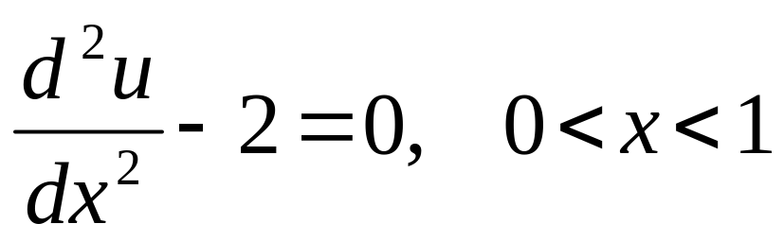
Finite Difference Method (FDM) : Introduction
One Dimensional Computations by FDM
In FDM derivatives in the governing equations are written in finite difference equations.
To illustrate, let us consider the second-order, one-dimensional differential equation:

Slide 15
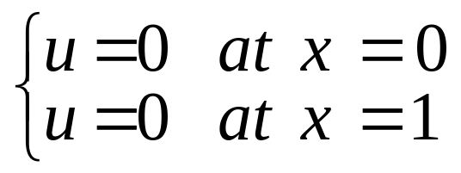
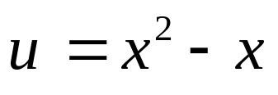
With Dirichlet boundary conditions (values of variable u specified at boundaries):
Exact Solution:
?
In FDM, solutions are computed at specific - discrete – points called Nodes.

Slide 16
The process of subdividing the domain into discrete points is called discretization.
Starting from x=0 the domain is subdivided in steps, until x=1. The chosen step is called step size and is denoted by Δx.

Slide 17

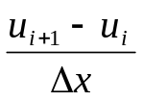
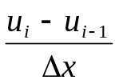
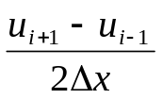





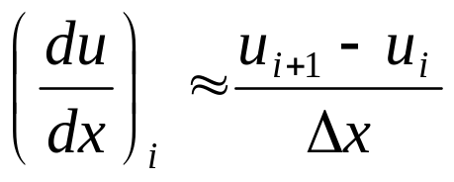
Finite Difference Equations:
Forward difference

Slide 18
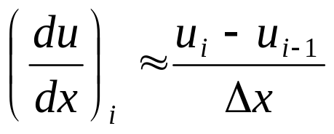
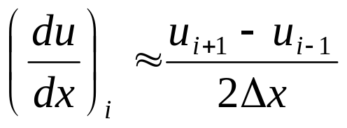
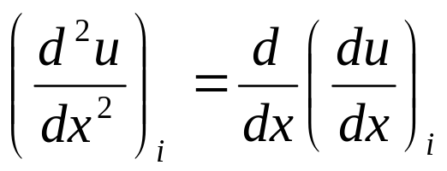
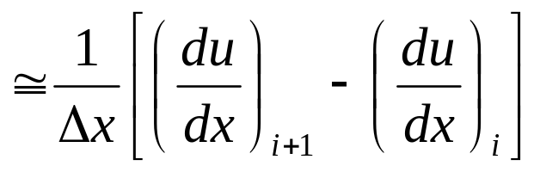
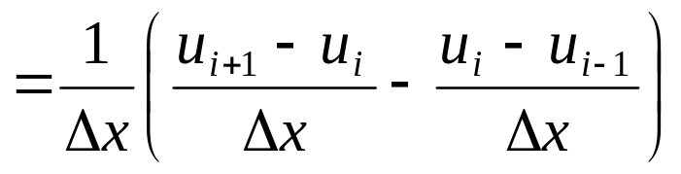
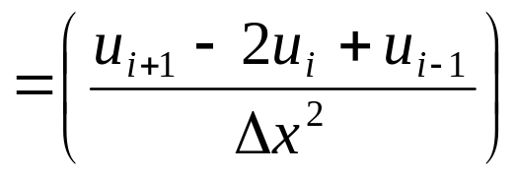
Backward difference
Central difference
Hence,

Slide 19
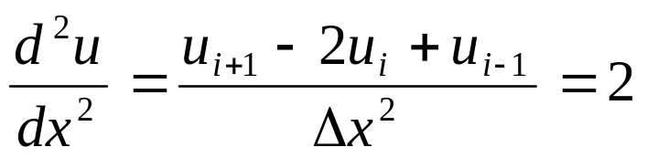
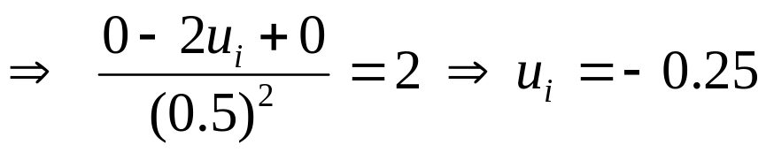

Therefore:
Given Boundary condition: u_{i-1}=0, u_{i+1}=0; and at point i, Δx = 1/2
From Exact Solution:

Slide 20




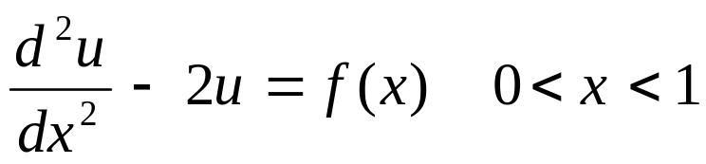

Example Problem
Consider the three-element system shown below.
And solve the differential equation shown below.

Slide 21
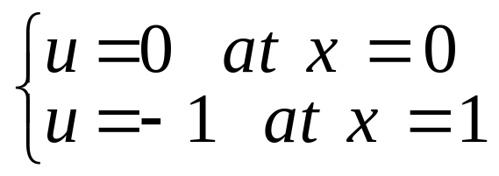

Subject to the Dirichlet boundary condition:
Whose exact solution:
?

Slide 22
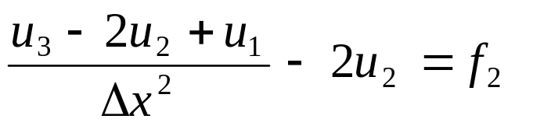
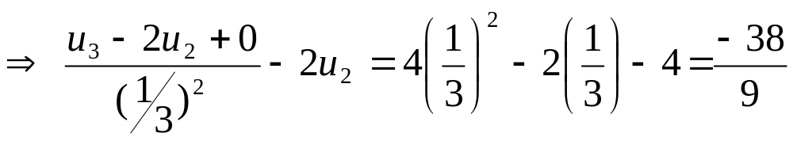
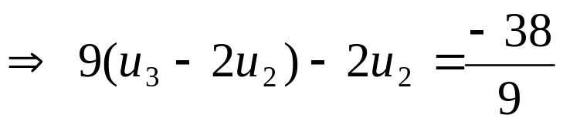
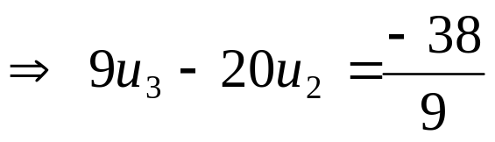
Solution
Write FDE at nodes 2 and 3:
Node 2:

Slide 23

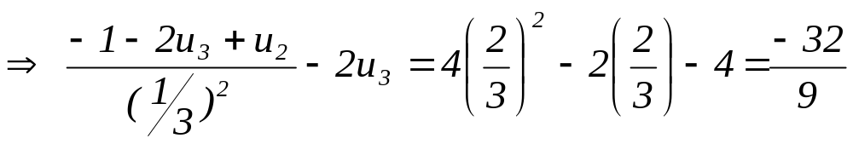
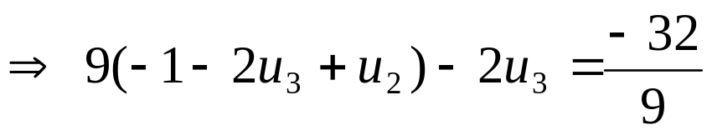
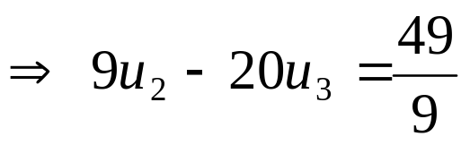
Node 3:

Slide 24
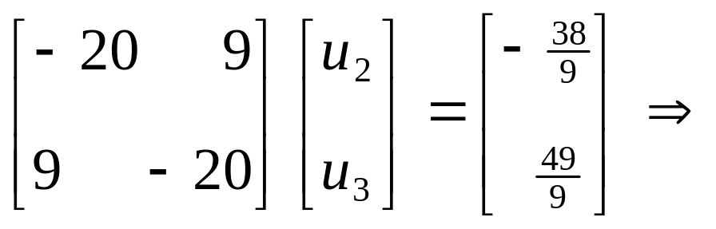
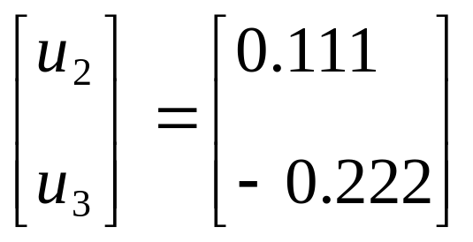
Combining, we have:
Exact Solution!!

Slide 25
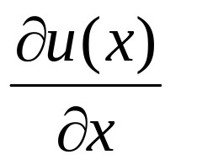
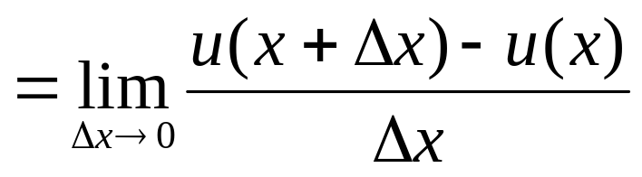
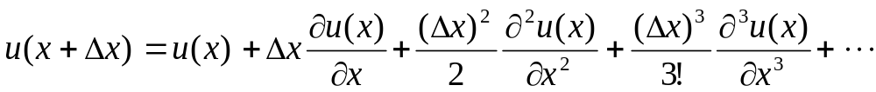
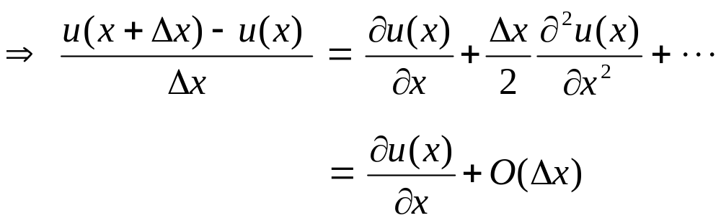
1 Derivation of Finite Difference Equations
- Consider a function u(x) and its derivative:
- Using Taylor’s series expansion we get:

Slide 26
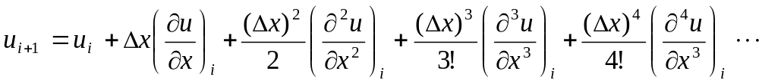
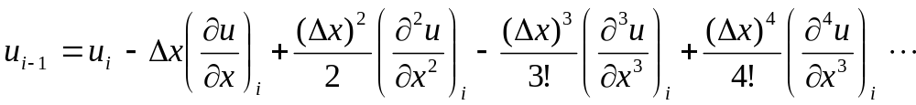
- Taylor’s series expansion:
(1)
(2)

Slide 27
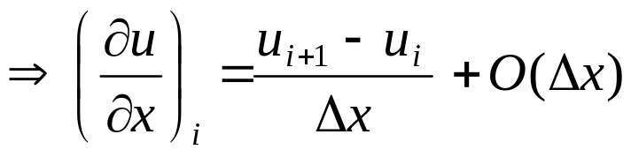
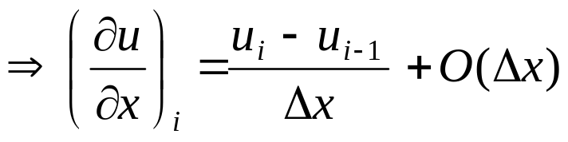
- Rearranging eqn. (1) we have:
Forward difference
Trunction error
- Similarly, rearranging eqn. (2) we have:
Backward difference
Trunction error

Slide 28
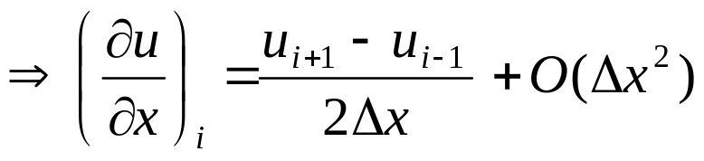
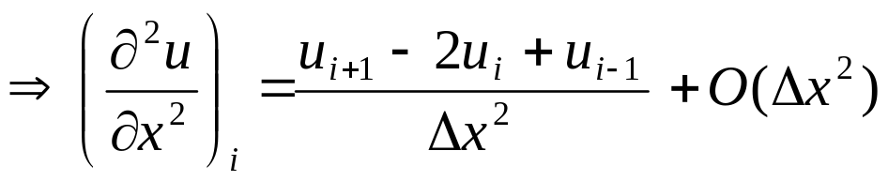
- Subtracting eqn. (2) from (1) we get:
Central Difference
Trunction error
- Finally adding eqns. (1) and (2) gives:
Trunction error

Slide 29
Assignment #1
Derive Terzhagi’s 1-D Consolidation Equation.
2. Derive Laplace’s equation for 2-D flow of water in soils.
Submission date: March 26, 2009

